Slide 1

Sharing Experience of Offering Course on SWAYAM:
Life Cycle of MOOC Course
Jagdish Arora
Director, INFLIBNET Centre
director@inflibnet.ac.in

Slide 2
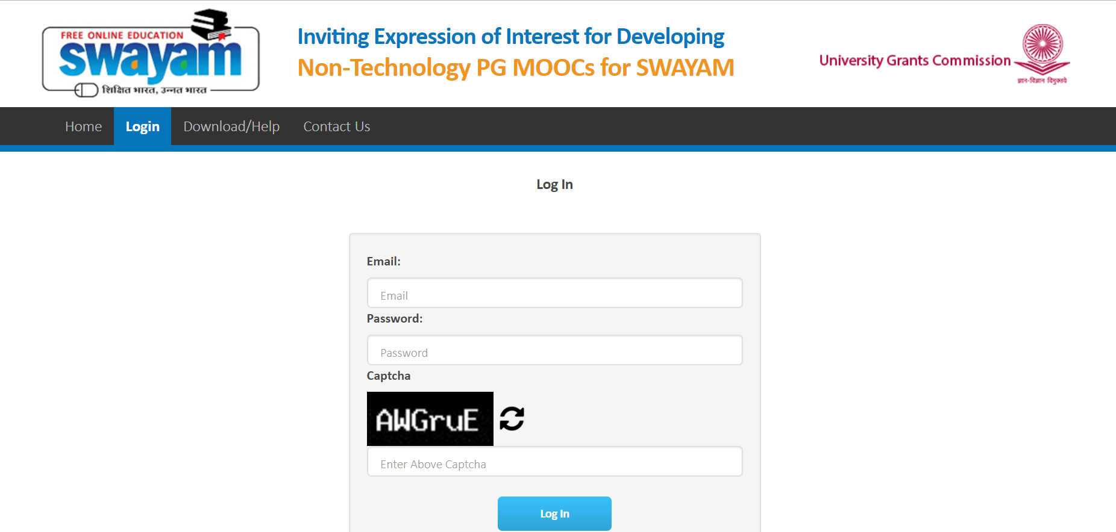
Course on Digital Library
15-week Course Offered Twice: First in Dec., 2016 (700 learners) and later in Dec., 2017 (1400 learners– Active 60) – In all seven courses in LIS
Contents were originally written for “Digital Library” paper in Library and Information Science under e-PG Pathshala project executed by the UGC
It consisted of 31 modules that were re-purposed. Two to three modules were packaged for each week
Additional modules were added to offer it as an independent course

Slide 3

Life Cycle of MOOC Course
01
02
033
04
Course proposal and approval
Content Development
&
Repurpose (if required)
Consent from University (for credit)
Course Announcement, Content uploading
08
05
06
07
Student Activity and Interact with student through forum and chat
Proctored Examination
Credit Transfer from the host institute
Student Enrolment and Course Delivery

Slide 4
1. Course Proposal and Approval
Submit the course proposal to UGC with justifications
Course overview
Target audience
Delivery mode (self paced / Scheduled)
Sign MoU with UGC / INFLIBNET / your Institution.
Get the funds released
Course approval by the National Coordinator

Slide 5


2. Content Development & Repurpose
Course Coordinator
Repurpose of existing Content
Course schedule for 10-15 weeks duration
Overall Course Introduction (5 Minutes video)
Weekly course introduction (2 minutes video)
Activities (4 activities & 4 Questions)
Weekly Assignments & Question – One liners
Self Assessment (MCQ) – Question bank
New Content with
four quadrant
Content Writers
Reviewers / Language Editors
Content for 10 / 15 weeks – depending upon credit of the course

Slide 6
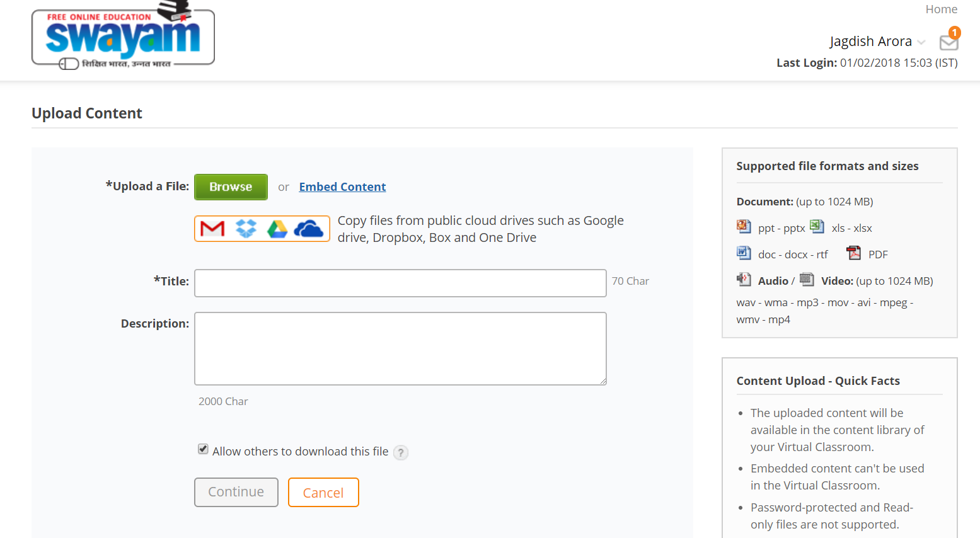
3. Consent from University (for Credit Transfer)
Obtain consent from a university who would recognize the course and transfer the credit
  Lengthy process
  Your own university
  Or any other University / degree awarding institution

Slide 7
4. Course Announcement / Content Uploading
Announce the course on SWAYAM portal
Course Introduction video & weekly introductory video
Upload the e-text to the content Library and arrange the content as per course schedule
Embed the video from Youtube for the respective module (self learn)
Upload self assessment questions for each modules
Upload activities and assignments every week

Slide 8
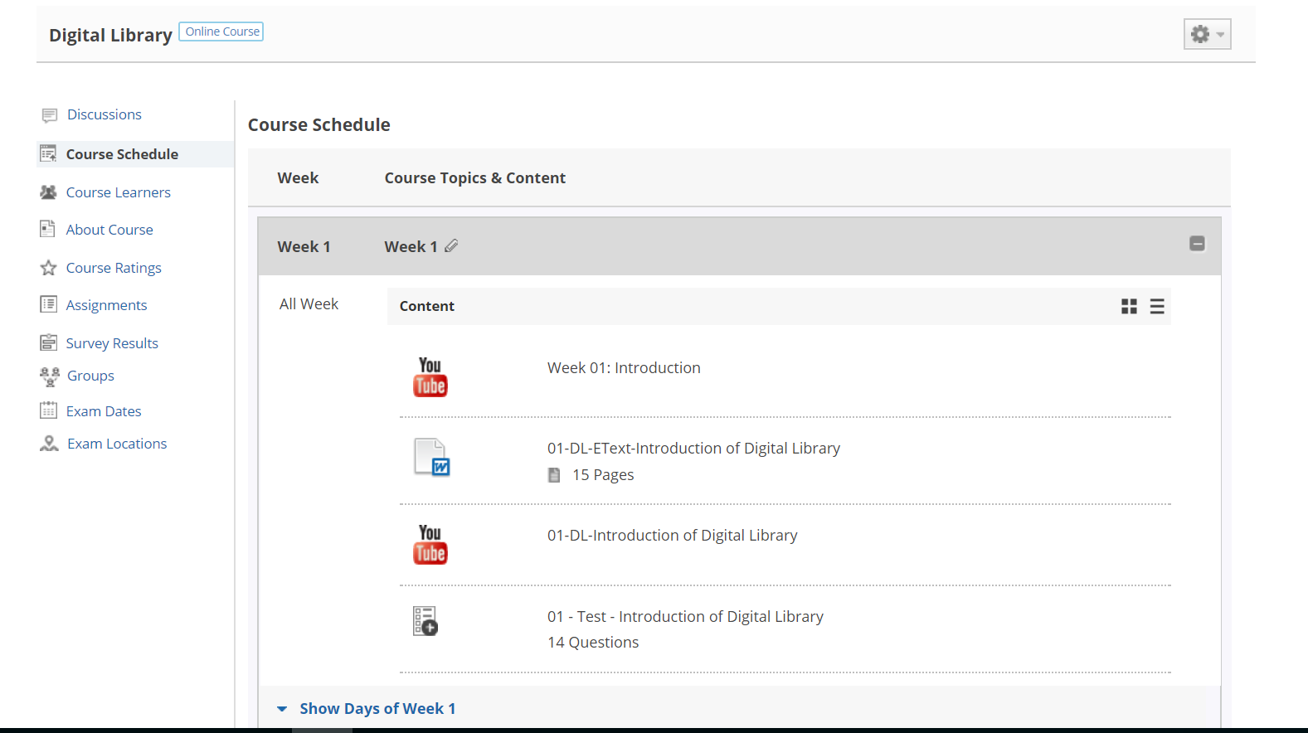
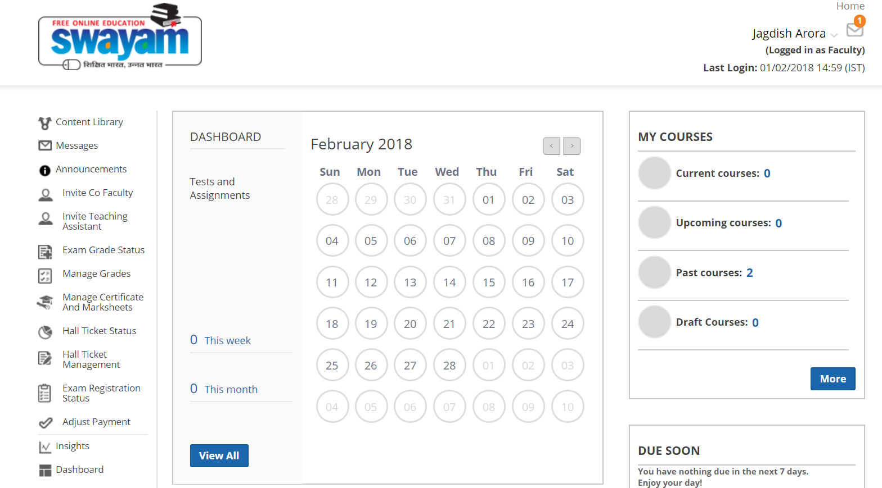
5. Student Enrolment and Course Delivery
Announce the course through SWAYAM and invite student to enroll into the course through social media, e-mail, formal and informal arrangements
Invite co-faculty to handle the course and invite the teaching assistant to assist the course coordinators
Deliver the course through SWAYAM as per the schedule

Slide 9

6. Student Activity and Interact with student through forum and chat
Send message and other regular notification to the learners through SWAYAM Platform
Student could start the discussion and the course coordinator moderate the discussion
Queries from the learners addressed by the fellow learners and coordinators
Learning progress of the learners could viewed by student and coordinators
Weekly assignment submitted by the students
Coordinators review the assignment and give the grade / or return to the student with his / her comments (for resubmission, if required)

Slide 10

7. Proctored Examination
Learners get weightage by SWAYAM portal for each activity such as
Reading the course material on the portal
Watching the video
Self assessment
Submission of assignment (by coordinator)
Decide threshold based on weightage
Eligible students are invited for the survey to know their willingness and preferable location to attend the proctored examination
Examination centers would be identified by the UGC and examination will be conducted
Learners get the credit based on the learning behavior and proctored examination

Slide 11
8. Credit Transfer from the host Institute
Learner gets the grade / weightage for weekly assignments, activities, quizzes, progress made, etc.
Proctored examination
Certificate or Credit transferred to his / her university

Slide 12

Feedback
SWAYAM portal is not fully compatible with four quadrants approach used in e-PG Pathshala (Learn More)
Student face problem in uploading assignments
Restrictions on number of words that can be used in the coordinator’s feedback on the student assignment
Watching of video / offline learning are not tracked or counted in the learning progress
Learning progress is not updated; difference in student dashboard and Course Coordinator’s dashboard
There is no control from the Course Coordinator to stop the registration of student after the commencement of course

Slide 13
THANKS

